Slide 1
Week 10
Supervised Learning: Classification

Slide 2
Today’s Agenda
Supervised Learning
Overview of classification
Regression vs classification
Model Validation
Naïve Bayes
Support Vector Machine
Random Forest

Slide 3
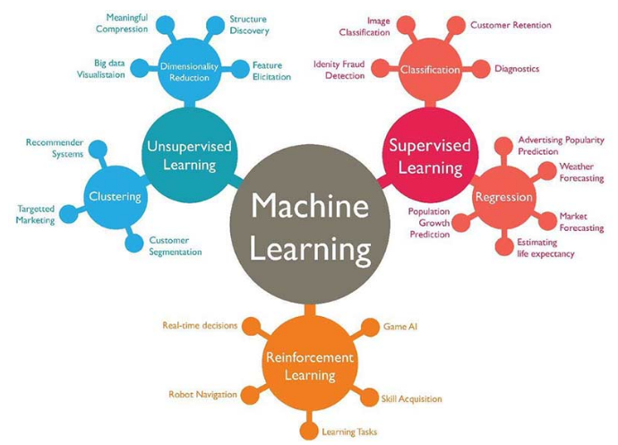
Categories of Machine Learning
Supervised learning: Associating features with some label. This is then divided into:
Classification: labels as discrete categories
Regression: labels as continuous quantities.

Slide 4
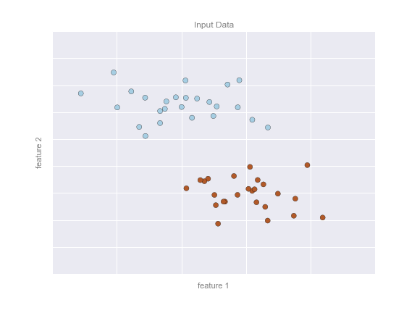
Supervised learning: Classification
Let’s look at some examples

Slide 5
Supervised learning: Classification
Let’s look at some examples
Here, we have a two-dimensional (read: two columns) dataset
We know which dots are blue and which are red.

Slide 6
Supervised learning: Classification
Let’s look at some examples
Here, we have a two-dimensional (read: two columns) dataset
We know which dots are blue and which are red.
The classification question then asks:
Can we create a “separator” model that separates these two points?

Slide 7
Supervised learning: Classification
Model: the quantitative version of “there is a straight line that can separate the two classes”.
Parameters: the intercept and axis (or however else we want to define our line) that describes the line

Slide 8
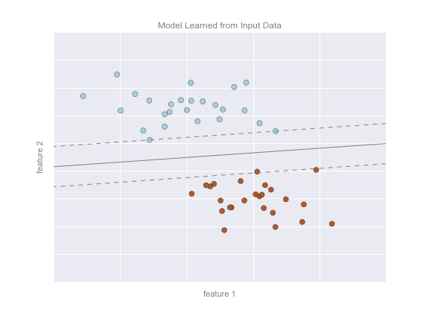
Supervised learning: Classification
So our model could look like this on the right.

Slide 9
Which is classification problem?
An e-commerce company using labeled customer data to predict whether or not a customer will purchase a particular item
A healthcare company using data about cancer tumors (such as their geometric measurements) to predict whether a new tumor is benign or malignant
A restaurant using review data to ascribe positive or negative sentiment to a given review
A bike share company using time and weather data to predict the number of bikes being rented at any given hour

Slide 10
Which is classification problem?
An e-commerce company using labeled customer data to predict whether or not a customer will purchase a particular item
A healthcare company using data about cancer tumors (such as their geometric measurements) to predict whether a new tumor is benign or malignant
A restaurant using review data to ascribe positive or negative sentiment to a given review
A bike share company using time and weather data to predict the number of bikes being rented at any given hour

Slide 11
Which is classification problem?
A regression problem is when we try to use any type (continuous or categorical) of data to predict outcomes that are continuous.

Slide 12
Regression vs Classification
A regression problem is when we try to use any type (continuous or categorical) of data to predict outcomes that are continuous.
A classification problem is when we try to use any type (continuous or categorical) of data to predict outcomes that are categorical.

Slide 13
Model Validation: Train-Test Split
Once we have trained our model, i.e. described this function that best separates our two classes (in this case), we can use the model to generalize and make new predictions

Slide 14
Model Validation: Train-Test Split
We typically split our data into train and test sets to evaluate the performance of a model.
The training set is used to find the mode
The test set is used to evaluate the performance

Slide 15
Model Validation: Train-Test Split
We want to give the model new, unseen data.
We do this to ensure the model can generalize well.

Slide 16
Model Validation: Train-Test Split
How do we divide the train and test set? No one-size-fits-all rule.
A common breakdown is 70/30 or 80/20 train vs test

Slide 17
Model Validation: Train-Test Split
The split might be determined by:
How big the overall data is. If the data is already pretty small, then you might want a larger training set to get enough data to learn.
If the data is large, perhaps a smaller split is fine.

Slide 18
Model Validation: Train-Test Split
You need to make sure your training data is representative of the larger sample.

Slide 19
Model Validation: Measuring Performance
One of the first measurements we can look at is the percentage of predictions we got correct: the accuracy score
# of predictions correct / all observations

Slide 20
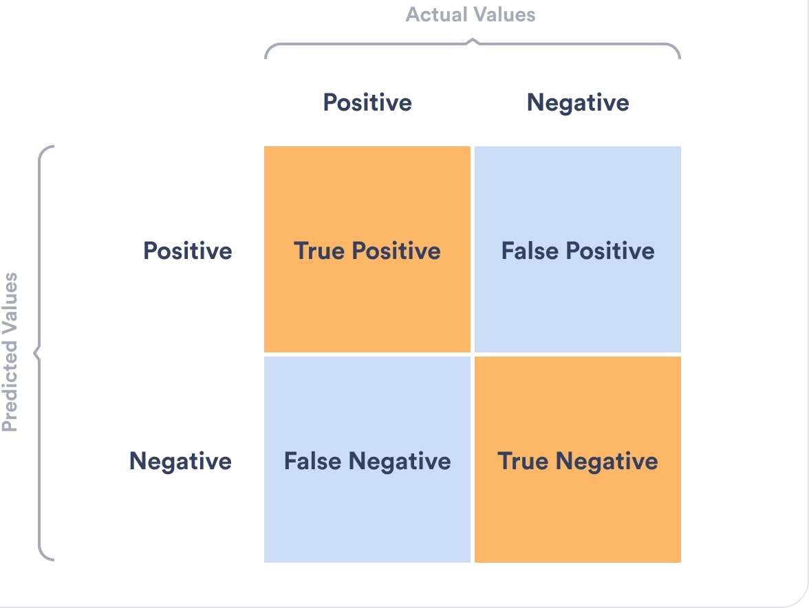
Model Validation: Measuring Performance
A confusion matrix gives us the following: TP, TN, FP, FN
In some scenarios, we might really care about the FP and FN.

Slide 21
Model Validation: Measuring Performance
When are FP costly in an urban context?

Slide 22
Model Validation: Measuring Performance
Land-use classification: If a commercial zone is misclassified as residential, it could lead to inappropriate construction of residential buildings in commercial areas.

Slide 23
Model Validation: Measuring Performance
Public safety: If a false positive is predicted in a crime hotspot prediction model, the police could deploy more officers to an area that is not at risk of crime.

Slide 24
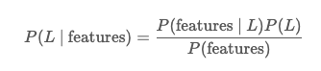
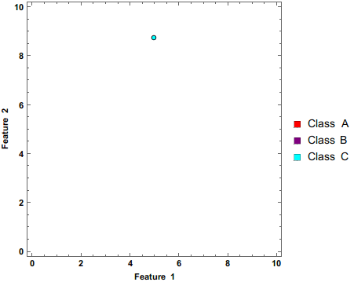
Naïve Bayes Classification
- We want to calculate the probability for each label L given the features we have (our independent variables).
- All we need to do is calibrate the probability we see certain features, given their label.

Slide 25
Naïve Bayes Classification
For ex: Say we are using Naïve Bayes to predict which buildings will get a historical landmark designation. We have features that include, architectural style, age, historical significance, cultural relevance, location, and other relevant factors.
Essentially, the algorithm looks a sample of test data where we know the building features and whether the building is landmark or not.
NB looks at the different characteristics of these buildings. For instance, it might find that:
Landmark buildings tend to be older buildings in the Beaux Arts style closer to the city center while non-landmark buildings are newer buildings further away from the city center
Then, when it sees new data, it will make a prediction based on these features.

Slide 26
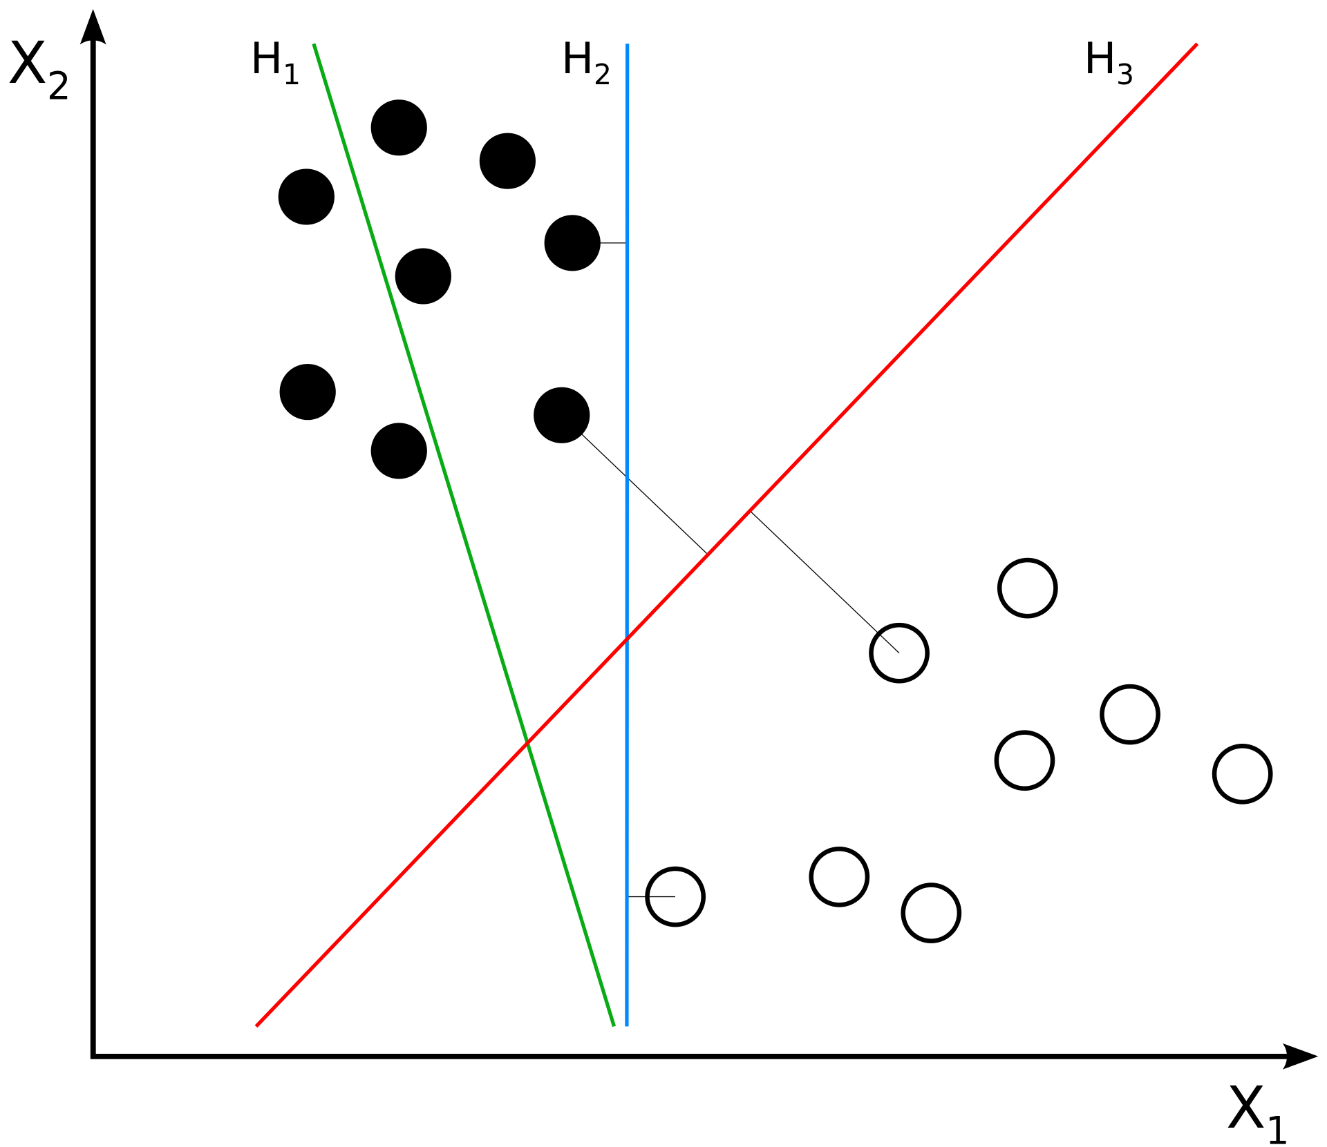
Support Vector Machine
We want to find a line/plane such that the distance between the line/plane and our nearest training data point on in any class is maximized.

Slide 27
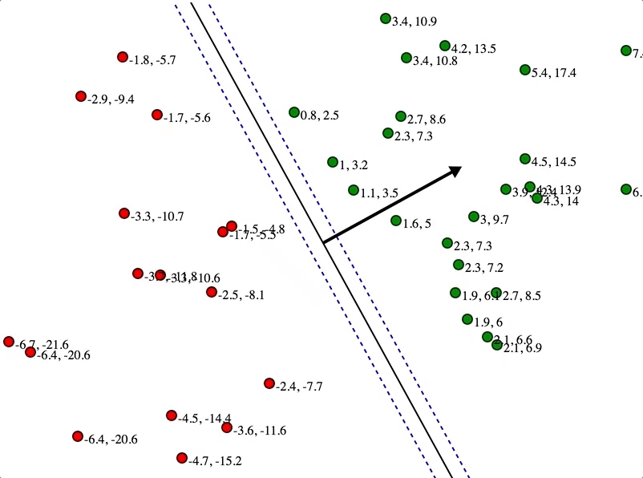
Support Vector Machine
Here, these numbers represent distances to the line

Slide 28
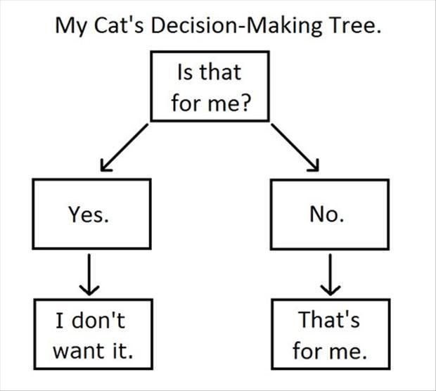
Decision Trees

Slide 29
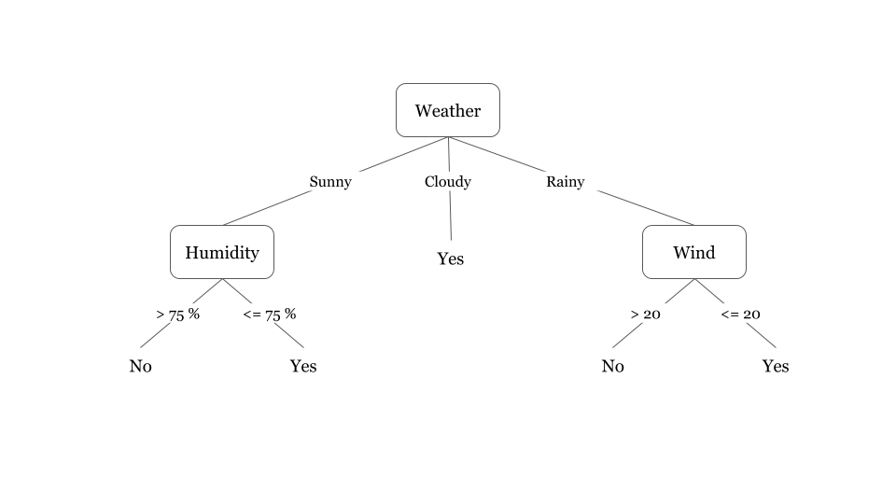
Decision Trees
Did I play badminton for each day of the week?

Slide 30
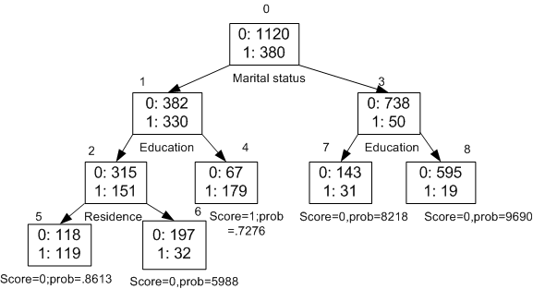
Decision Trees
What causes someone to make big purchases?

Slide 31
Decision Trees
We are going to select a split in the tree that is best able to separate our data into its purest target classes.

Slide 32
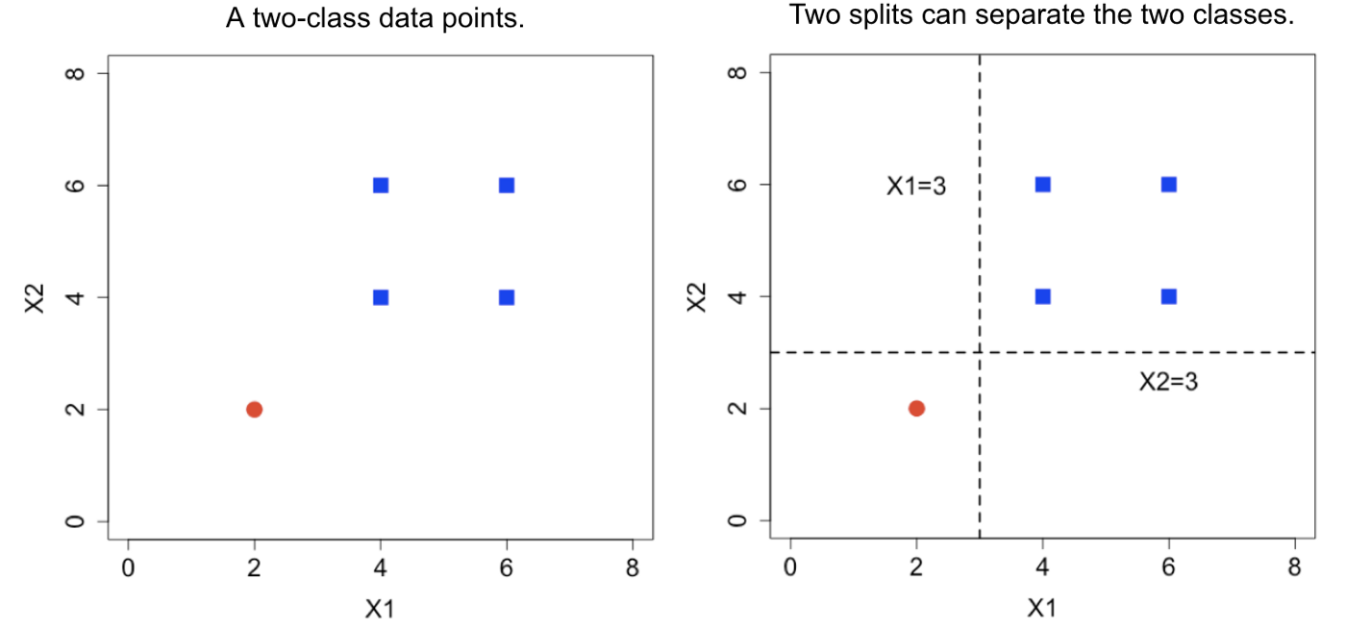
Decision Trees
This is another way to visualize the decision tree
Notes:
This is another way to visu

Slide 33
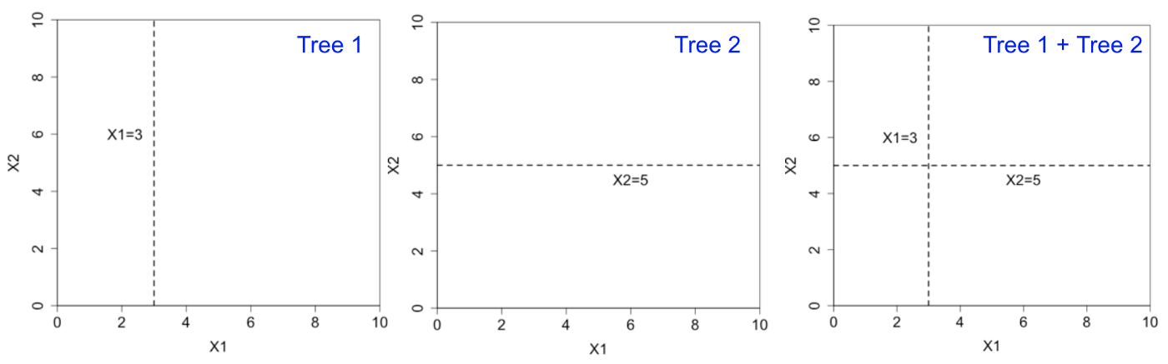
Ensemble Methods
Imagine if we had multiple (typically shallow) trees
Notes:
This is another way to visu

Slide 34
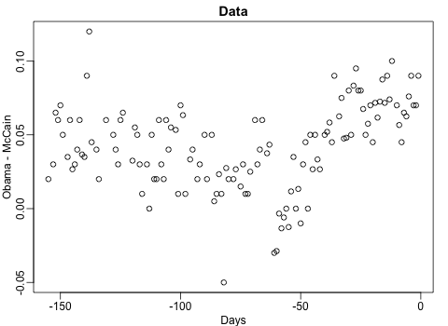
Ensemble Methods
Ensemble methods combine multiple decision trees to improve their accuracy and stability.
Notes:
This is another way to visu

Slide 35
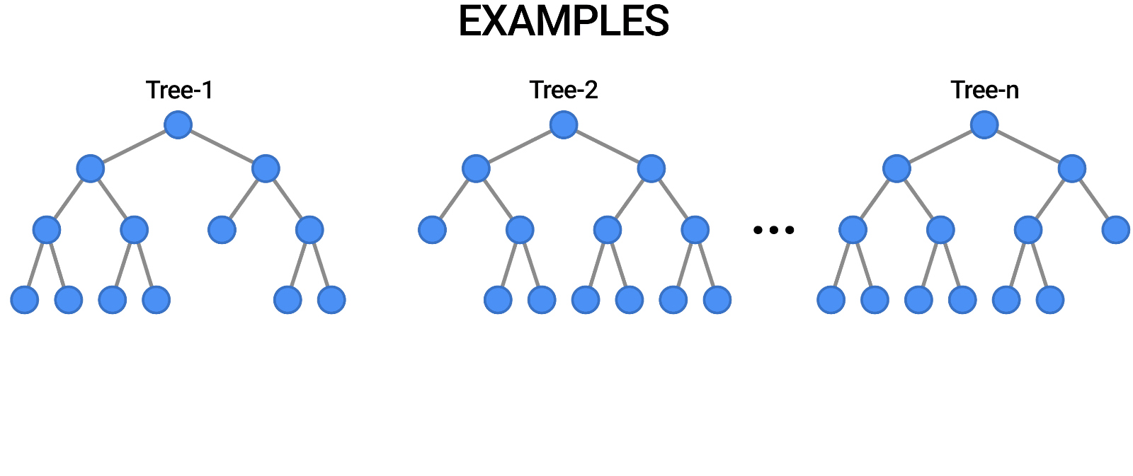
Ensemble Methods: Random Forest
Tree in the random forest is trained on a subset of the data and a random subset of the input features.
So each tree makes decisions based on a different subset of features.
To make a prediction for a new data point, the random forest takes the majority vote of the predictions of all the individual decision trees. T
Notes:
This is another way to visu

Slide 36
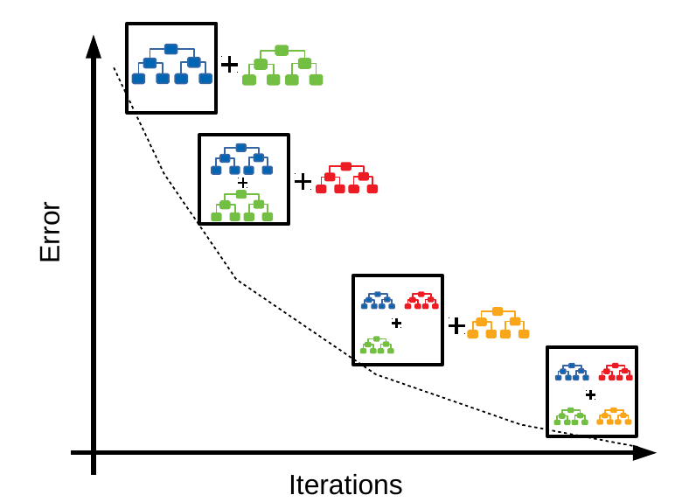
Ensemble Methods: Gradient Boosting
Iteratively creates one decision tree, with each subsequent tree correcting for misclassifications in the previous tree.
To make a prediction, all trees are used but each tree's prediction is weighted based on its accuracy.
Notes:
This is another way to visu

